Slide 1
Java Lab Assignment #7 Get the radius of a circle using constructors – Nicholas Carroll – 3 December 2018

Slide 2
Analysis – what is known and given?
A constructor allows the user to initialize an object as soon as it’s created.
Using constructors will allow for a more fluid program and make it so that the user doesn’t have to keep re-writing lines of code to apply the same methods to different objects.

Slide 3
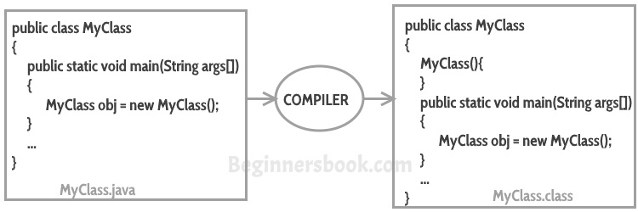
Example
The main Java program is calling to a new instance of MyClass. Creating constructors is essential for simplicity.

Slide 4
Analysis cont.
Inside our constructor class, we can create variables and define methods so that in the main class, we will be able to continually reuse these lines of code.
It’s important to note that parameters that we give in the main class will be arguments that are accepted in the subclass or constructor.

Slide 5
Algorithm
Create the package, create the MainCircle class respectively.
Create the main method.
Create an instance of the Circle class to a variable named c1.
In Eclipse, create a new Java class called Circle.java.
Create double instance variables for radius, area, perimeter and pi. Only pi will be initialized to 3.14159.
As called from the main class, create the Circle constructor and set radius, area and perimeter equal to 0.

Slide 6
Algorithm cont.
Create three new methods called getRadius, getArea and getPerimeter, give respective arguments to each and inside each method, return a result using mathematical formulas for calculating the area and perimeter of a circle.
End the Circle class.
In the main class, print the radius, area and perimeter with each respective parameter (r = 20, p = 20, a = 20, pi = 3.14159) by calling the methods that were created in the constructor class.
End the main class.

Slide 7
Test Case
Output:
“With radius: “ 20
“The area of the circle is: “ 197.39
“The perimeter of the circle is: “ 125.66
// radius = 20, area = 20, perimeter = 20, pi = 3.14159

